Slide 1
Book Recommendation System
Barah (C0860531)
Catharin Jose (C0860087)
Danny Jose (C0864600)
Sri Bindu Chintakayala (C0857498)
AIMT DEPARTMENT, LAMBTON COLLEGE
2022F AML 2203 1 Advanced Python AI and ML Tools
PROFESSOR VAHID HADAVI
NOVEMBER 26, 2022

Slide 2
Table of contents
Data Preparation
Data Cleaning
Feature Engineering
Exploratory Data Analysis
Top Ten books as per ratings
Collaborative Filtering
Memory-Based approach - Cosine Similarity
Model-Based approach – Singular Value Decomposition (SVD)
Model Evaluation Metrics
RMSE score with each collaborative filtering approach
Getting top recommendations for books and ratings

Slide 3
Data Preparation
Dataset - The Book-Crossing dataset comprises 3 files. Users, Books and Ratings
Libraries used- NumPy, Pandas, matplotlib, seaborn and sklearn, model_selection, pairwise_distances, mean_squared_error, surprise
Data Cleaning
Missing values handling-
In the Books dataset, we have observed very few null values in book author and publisher columns
In the User dataset, the age column has missing values, and those values are handled by replacing them with the average age of the column.
In the Rating dataset, missing values were not found

Slide 4
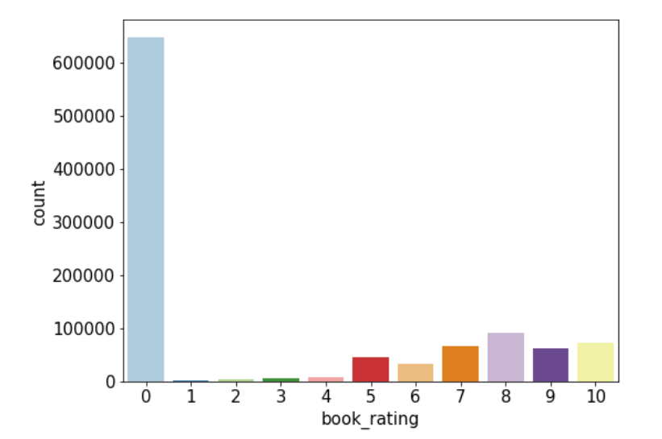
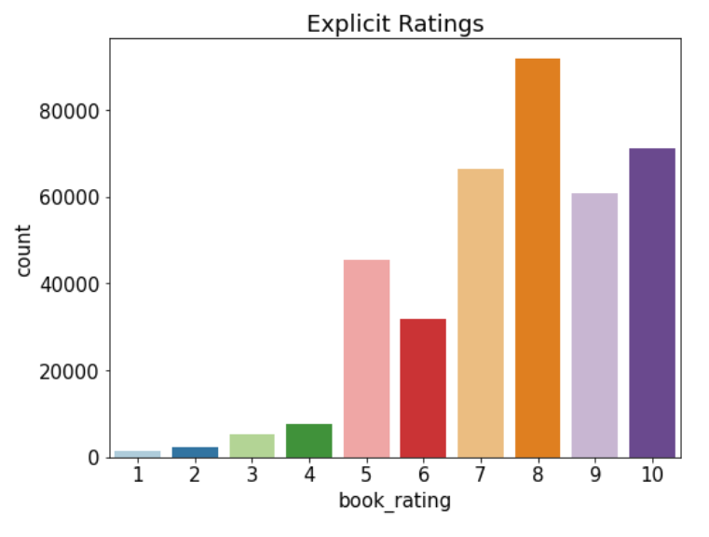
Feature Engineering
The two column names of 'book_author’ and ' year_of_publication' we found mismatched, so we have corrected the error.
In the Rating dataset, ratings were unevenly distributed, so we tried to split the data into two ways implicit and explicit. We separated explicit ratings by 1–10 and implicit ratings by 0.
We dropped features like image URLs. Replaced feature with lowercase and ‘-‘ to build a space between words. Only considering ages between 5-90.

Slide 5
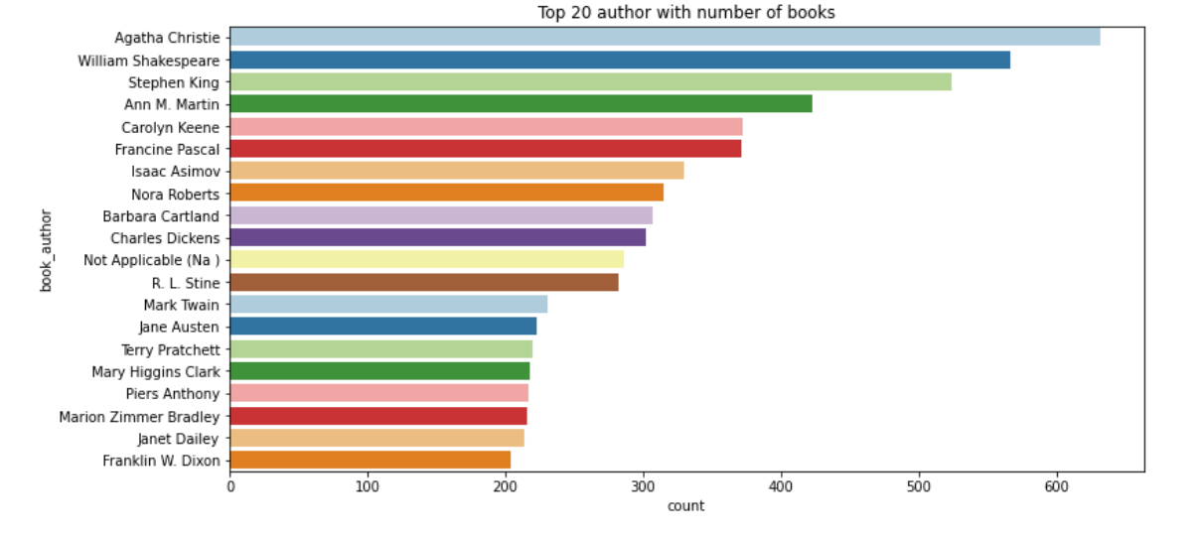
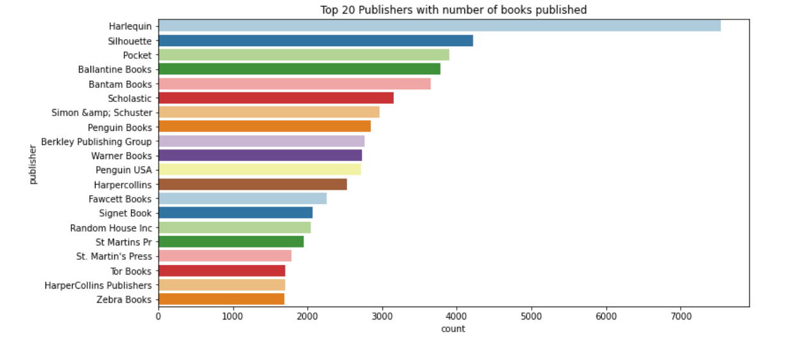
Exploratory Data Analysis
Agatha Christie is leading at the top with more than 600 counts, followed by William Shakespeare.
Harlequin has the most number of books published, followed by Silhouette.

Slide 6
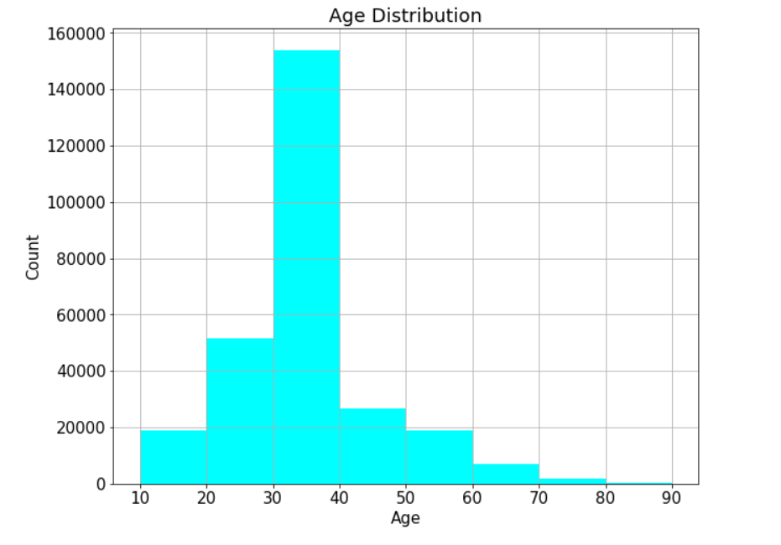
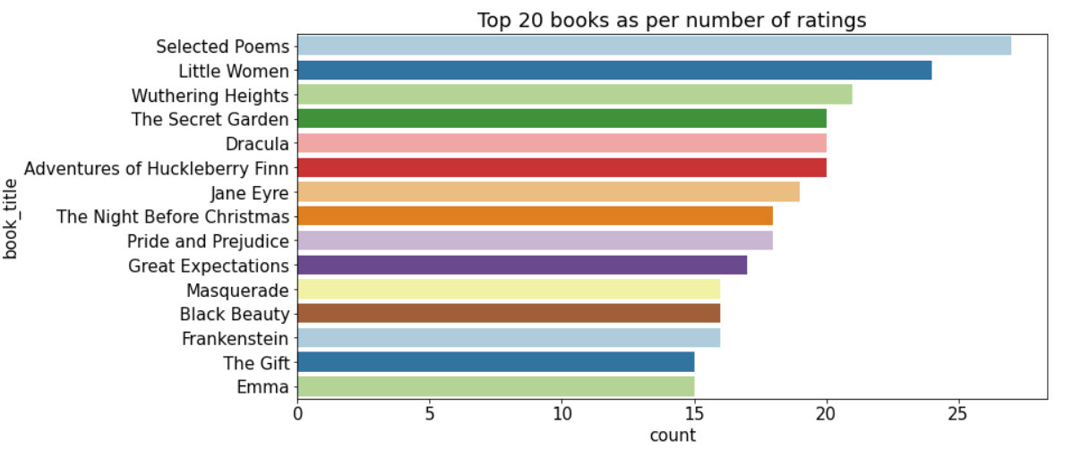
Exploratory Data Analysis
The highest number of users are between the age group of 30 to 40
As per ratings "Selected Poems" has been rated most followed by "Little Women"

Slide 7
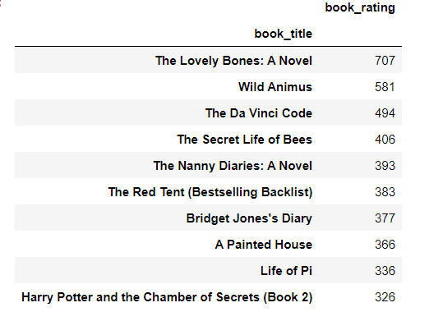
Top Ten Books as per explicit ratings
We are building a recommendation system based on ratings. This recommendation is given to every user irrespective of personal characterization. We must separate the explicit ratings (ratings from 1–10)
Merging book_data dataset and ratings_explicit. Considering ISBNs that were explicitly rated for this recommendation system.
The recommendations in the figure are the top 10 books recommendations as per ratings. But this is not based on any recommendation system. They are top 10 books as per ratings.

Slide 8
Collaborative Filtering
This approach uses the memory of previous users’ interactions to compute users’ similarities based on items they’ve interacted with (user-based approach) or based on items’ similarities based on the users that have interacted with them (item-based approach).
Training set lengths: 307073 Testing set lengths: 76769 The test set is 20% of the full dataset. Columns are user id, ISBN and book ratings.
Memory-Based approach - Cosine Similarity
A distance metric commonly used in recommender systems is cosine similarity, where the ratings are seen as vectors in n-dimensional space, and the similarity is calculated based on the angle between these vectors.
Item-based CF RMSE: 7.952000184808946 User-based CF RMSE: 7.951837676306677 By cosine similarity in the recommendation system, it gives a 7.95 RMSE score. We can make improvements in this score by using the Single Value Decomposition model (SVD) model.

Slide 9
Model-Based approach – Singular Value Decomposition (SVD)
Model-based collaborative filtering algorithms provide item recommendations by developing a model of user ratings.
SVD is a matrix factorization technique. It reduced the number of features of a dataset by reducing the space dimension from N-dimension to K-dimension (where K<N).
SVD uses a matrix structure where each row represents a user, and each column represents an item. The elements of this matrix are the ratings that are given to items by users.
RMSE score- 1.63

Slide 10
Testing Results
To test the result, a user id and ISBN have been taken.
User Id - 276744 ISBN - '038550120X'
The estimated rating for the book with ISBN code 038550120X from user #276744 is 7.48.
The actual rating given for this was 7.00.

Slide 11
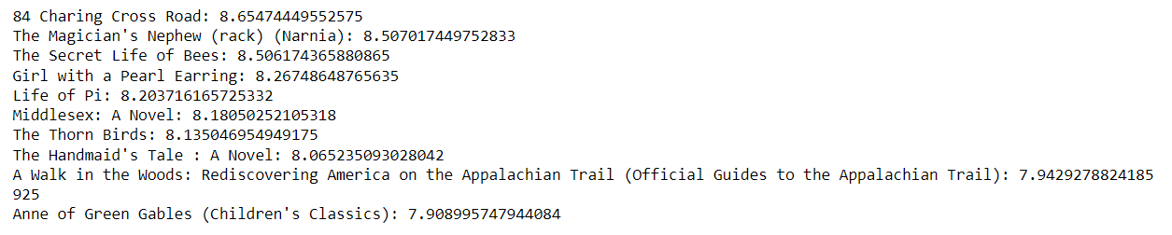
Getting top recommendations for books and ratings
First, map the predictions to each user
Then sort the predictions for each user and retrieve the k highest ones
We took a random User id 32440
We have the top recommendation of books and ratings respective to them.

Slide 12
Conclusion
Among the top 20 Authors, the highest number of books has been held by Agatha Christie. Agatha Christie is leading at the top with more than 600 counts, followed by William Shakespeare.
Harlequin has the most number of books published, followed by Silhouette.
Number of Books published yearly between 1950 - 2005.
Most of the users between 30-40 prefer more books, and somewhat we can also view between 20-30.
As per ratings, "Selected Poems" has been rated the most, followed by "Little Women.” The counterplot shows users have rated 0 the most, which means they haven't rated books at all.
The top 10 books recommendation as per ratings with top "The Lovely Bones: A Novel" with 707 book ratings. But this is not based on some recommendation system. They are top 10 books as per ratings.
As we perform by cosine similarity in the recommendation system, it gives a 7.95 RMSE score, and SVD improved score to 1.63 RSME score by Singular Value Decomposition model (SVD).
The evaluation metrics for SVD are the best RMSE score for all datasets.
As model-based approach was best to signify, and at last, we got the top 10 recommended books and ratings, respectively.

Slide 13
Any questions..??

Slide 14
Thankyou…

